Slide 1
ChemE 599: Image Analysis for Scientists and Engineers
Lecture 0: Course Overview
Prof. Chad Curtis
Mar. 31, 2020

Slide 2
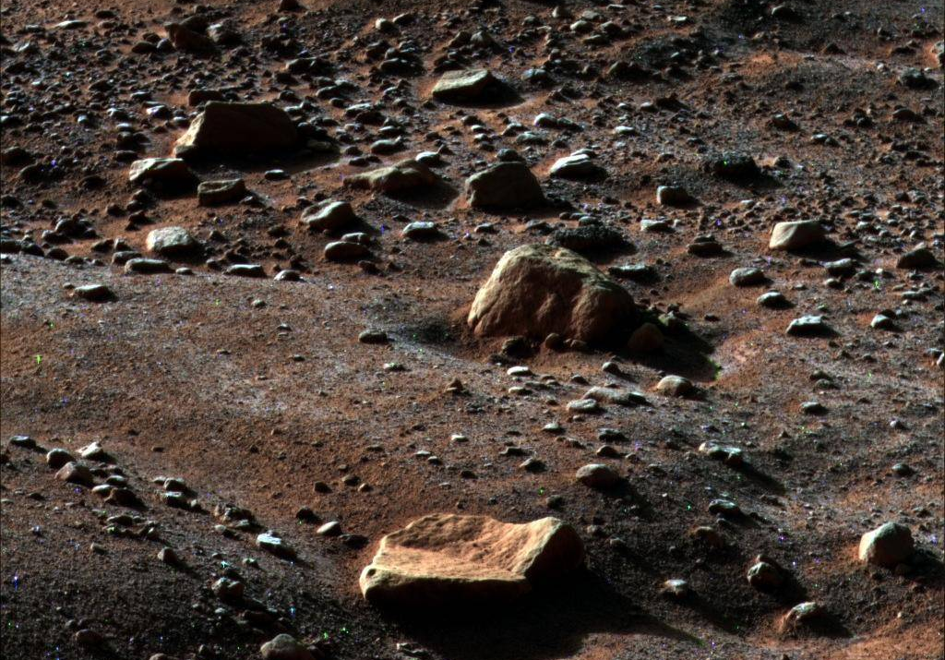
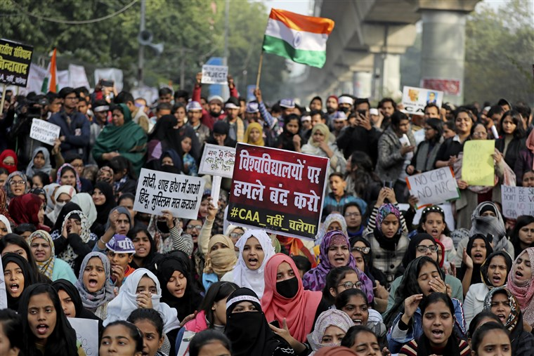
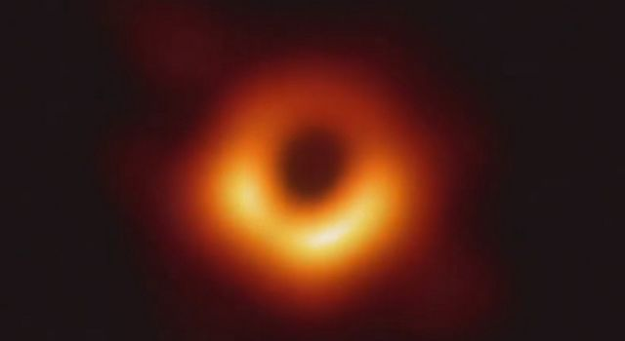
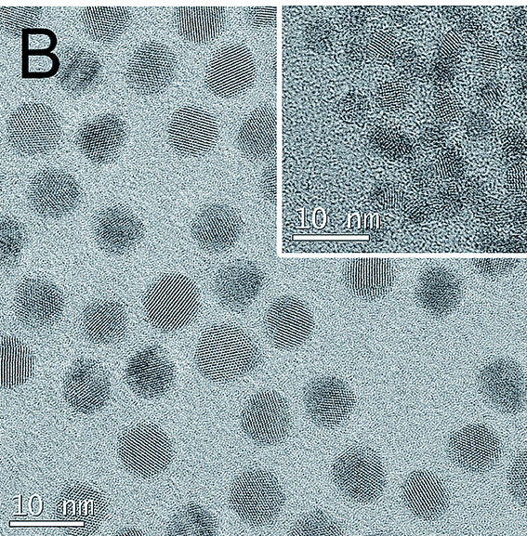
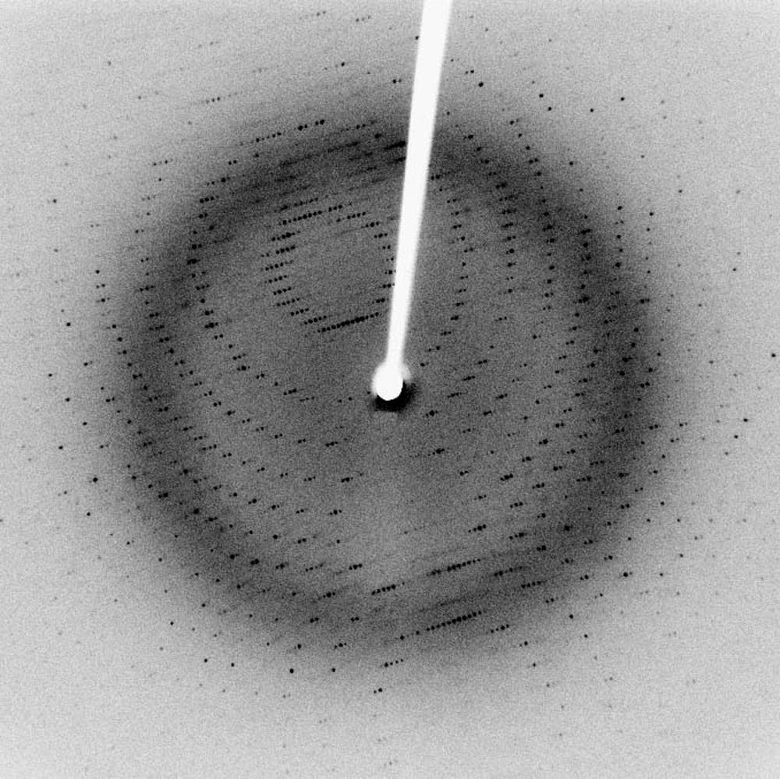
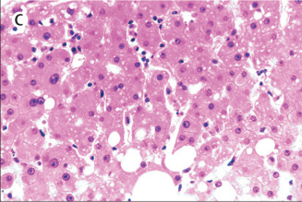
Images as Data
Notes:
Image 1: Frost on Mars, take from the Phoenix rover
Image 2: Quantum dots taken from Mengying
Image 3: Liver tissue of COVID-19 patient
Image 4: X-ray crystallography
Image 5: Black hole
Image 6: Twitter/violence study

Slide 3
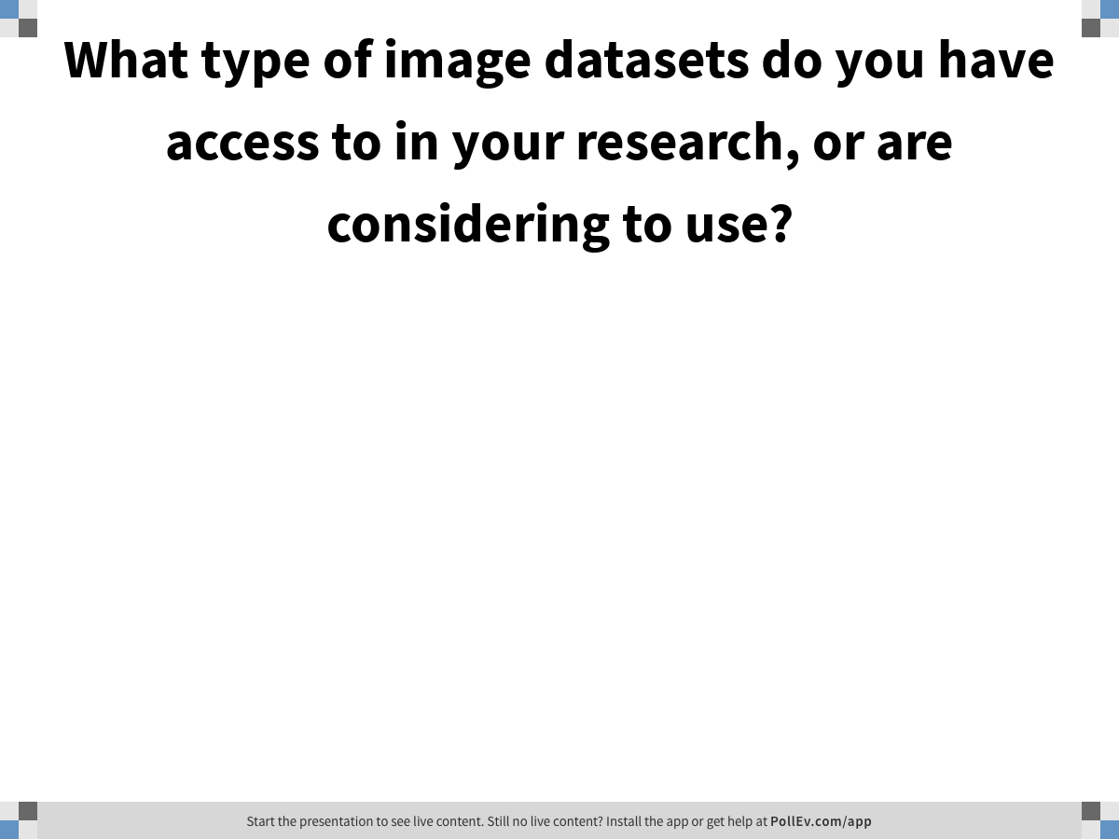
Notes:
Poll Title: What type of image datasets do you have access to in your research, or are considering to use? https://www.polleverywhere.com/free_text_polls/mRTLpInvn7fpZv0KNcelZ

Slide 4
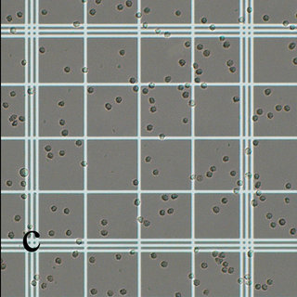
Hemocytometer images: Image morphology
Problem: I have hundreds of hemocytometer images to perform cell counts, but I think I could make this process much quicker if I could automate the process.
Possible solutions: binarize image into cells (black) and background (white); Canny edge detector
Problems: False positives (objects that are not cells counted as cells); false negatives (cells missed); overlapping cells; what threshold to use; non-uniform lighting

Slide 5
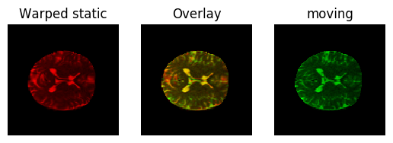
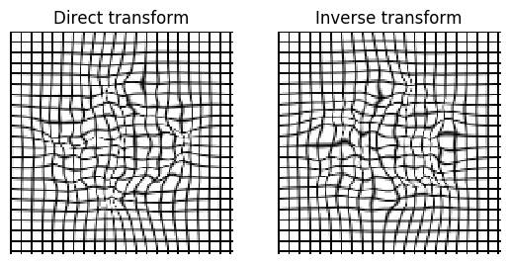
Neuroanatomical Datasets: Image registration
Problem: I am trying to compare stacks of MRI images of different patients, but I can’t compare them directly because they have different frames of reference.
Possible solutions: diffeomorphic image registration
Problems: Images aren’t similar enough, images are too big to process effectively

Slide 6
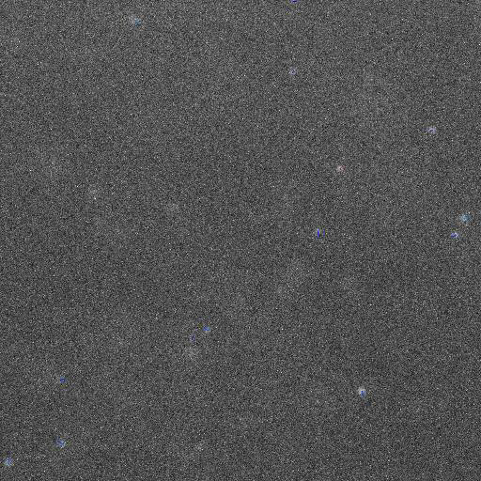
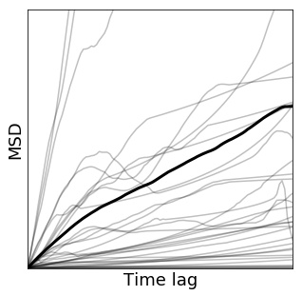
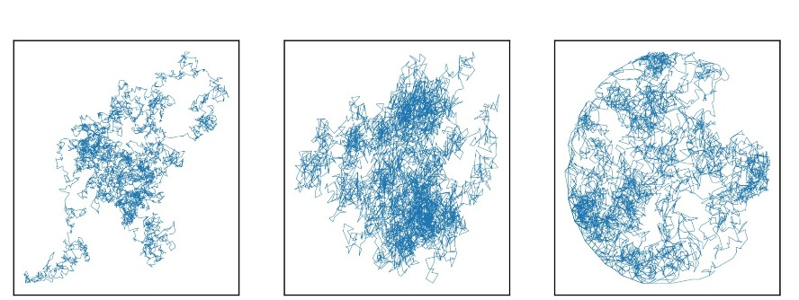
Diffusing nanoparticles: Feature tracking and machine learning
Problem: I have videos of nanoparticles diffusing in different conditions, and I want to quantify the differences in their behavior.
Possible solutions: feature identification and tracking
Problems: false positives, false negatives, frame rate, objects leaving frame

Slide 7
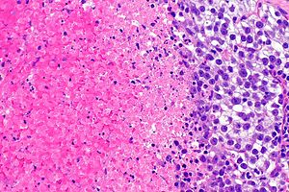
Quantify tissue damage: Object recognition
Problem: I have images of tissue samples with varying levels of tissue damage. I want to be able to automate a process ot identify the level of tissue damage.
Possible solutions: (1) define descriptors and assign thresholds, (2) use a machine learning algorithm to identify levels of damage in tissue
Problems: (1) Thresholds defined arbitrarily, potential contributions you aren’t catching, (2) less ability to interpret, differences between images not directly related to tissue damage.

Slide 8
Take 5 minutes to either (a) find a representative image from an image dataset you work with or (b) an image dataset you find interesting from one of the sources below.
Afterwards, discuss with your breakout team, share it with your team (test out whether you can share your screen), and discuss possible analyses you would like to perform.
https://data.nasa.gov/browse
https://www.nature.com/sdata/
https://digital.lib.washington.edu/researchworks/

